Slide 1
Predicting Sales Price in Ames, Iowa
By: Thomas Ouyang

Slide 2
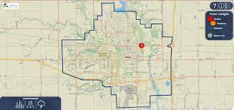
Introduction
Ames is a small city in Iowa
Iowa State University
Population: ~66,000
Goal: Predict Sales Price
Are there any important features that may stand out?

Slide 3
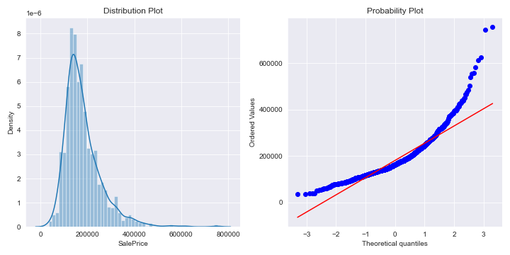
Exploratory Data Analysis
Target Variable: Sale Price
Not Normally Distributed
Log Transformation?

Slide 4
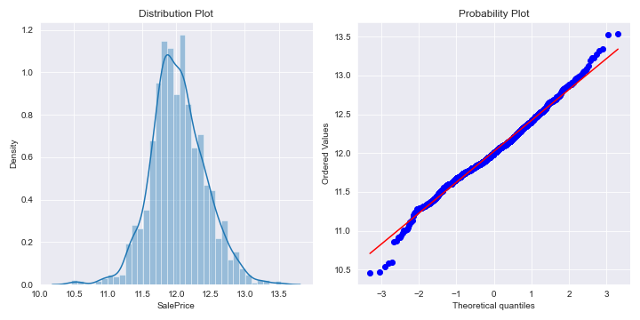
Exploratory Data Analysis
Target Variable: Log Sale Price
More Normally Distributed

Slide 5
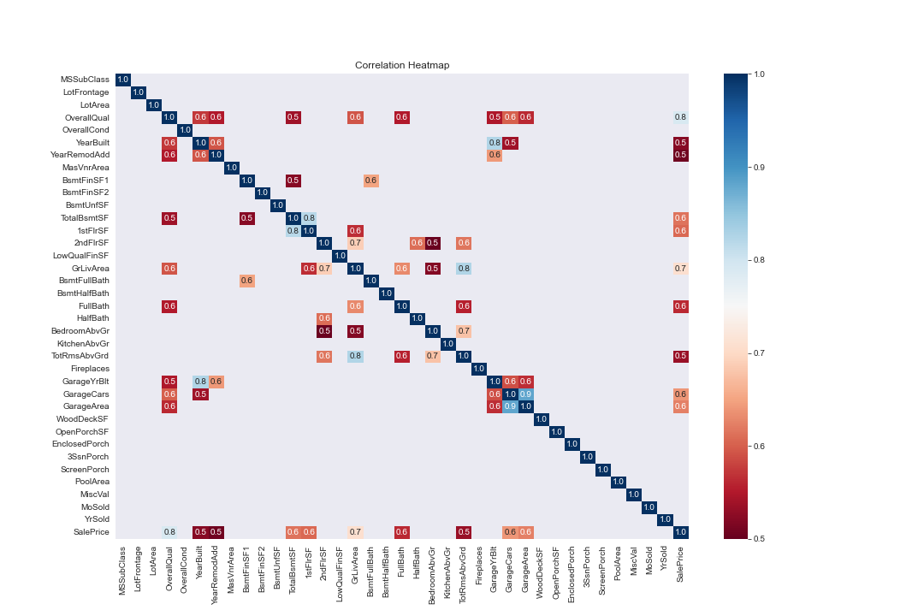
Exploratory Data Analysis
Multicollinearity:
GarageYrBlt and YearBuilt
1stFlrSF and 2ndFlrSF
TotRmsAbvGrd and GrLivArea
GarageArea and GarageCars
GrLivArea and 2ndFlrSF
Drop variable that is least correlated with target variable

Slide 6
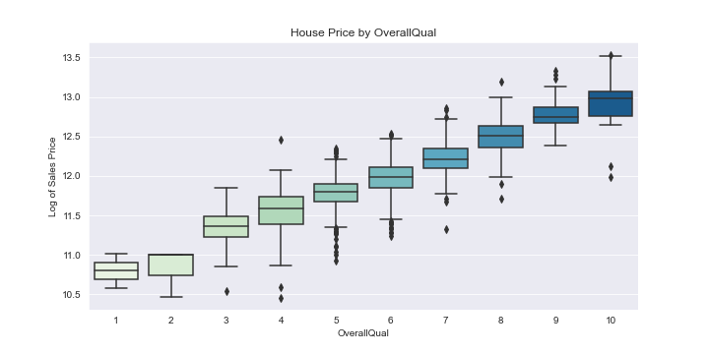
Exploratory Data Analysis
Linear Relationship Example:
Overall Quality of House

Slide 7
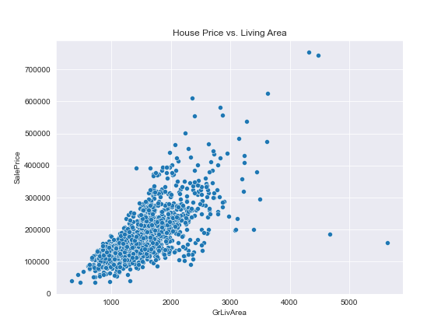
Exploratory Data Analysis
Outliers:
Used Robust Scaler to handle outliers
GrLivArea Example

Slide 8
Exploratory Data Analysis
Missing Values:
Numerical Features: Replace “NA” with sample median.
LotFrontage: Replaced missing values with the median of the neighborhood the house is in
Categorical Features: Replace “NA” with “none”.

Slide 9
Feature Engineering
Ordinal Variables: Label Encoded
Nominal Variables: One-hot Encoded (dummified)
New Variables: totalSqFt and totalBath
Removed the 100 least correlated features
Note: I created a copy of the data and label encoded all categorical variables for my tree models.

Slide 10
Modeling
Linear:
Multiple Linear Regression
Ridge Regression
Lasso Regression
Elastic Net
Tree-Based:
Random Forest
Gradient Boosting
Light GBM
XGBoost
Goal: Find Model with lowest RSME

Slide 11
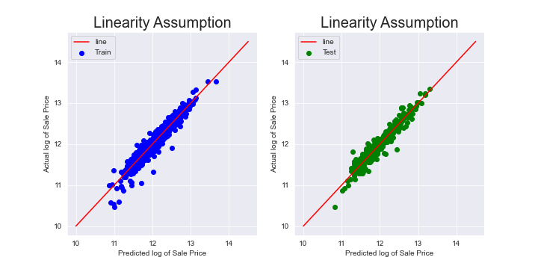
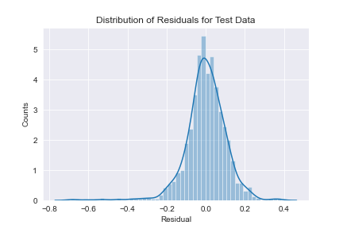
Linear Regression
Showcase two assumptions:
Linear Relationship
Homoscedasticity

Slide 12
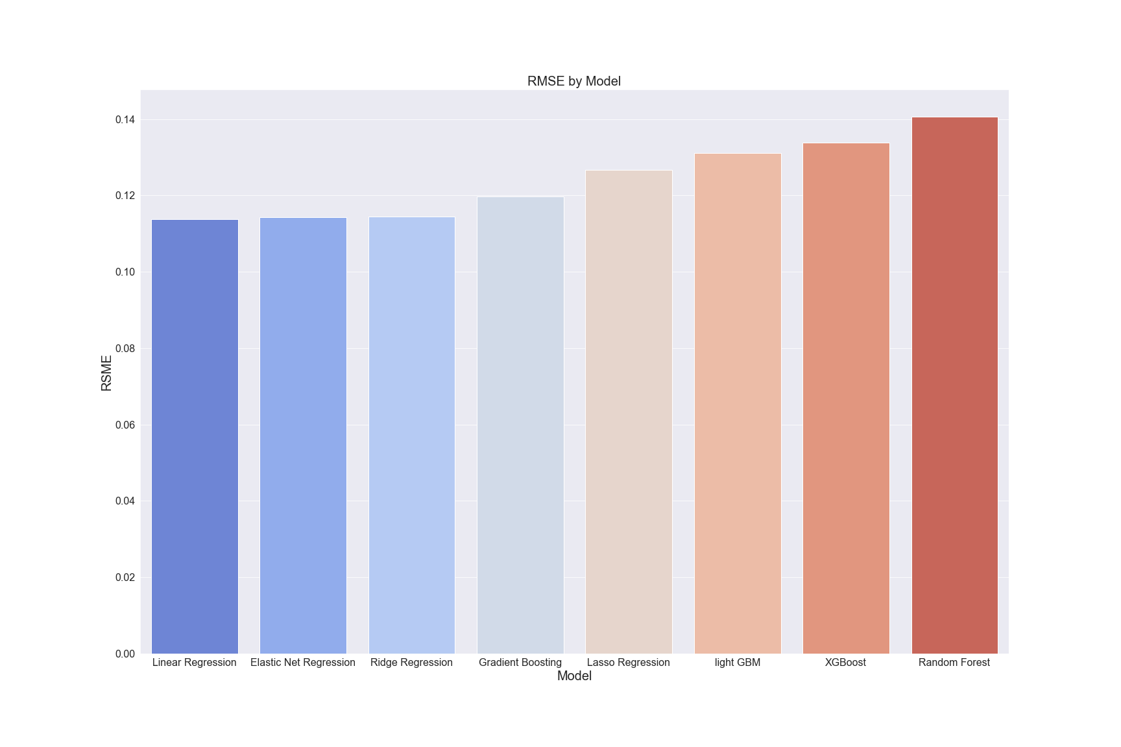
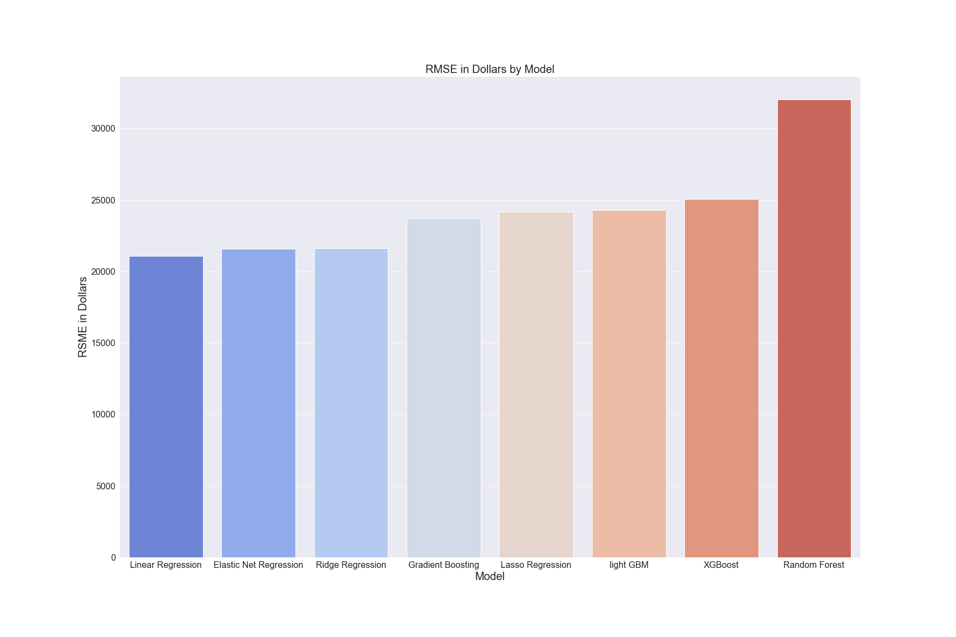
Results:
Linear Regression had the best RMSE
r^2: 0.9234
RMSE in Dollars: 21,082.02

Slide 13
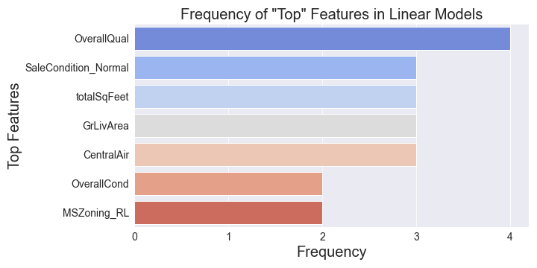
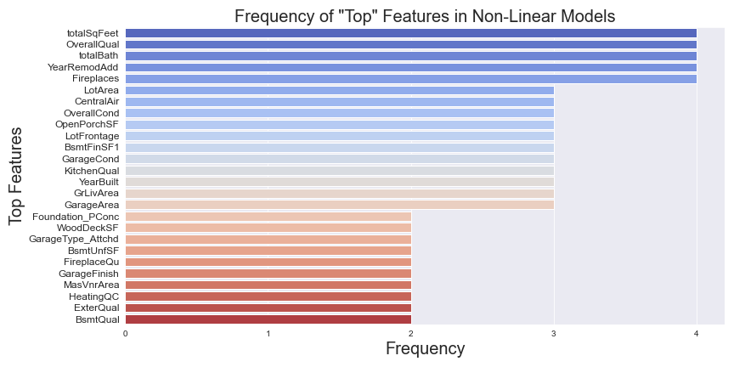
Best Features
Linear Models:
Overall Quality (every model)
Non-Linear Models:
totalSqFeet
totalBath
YearRemodAdd
Fireplaces

Slide 14
For the Future:
Improve EDA and Feature Engineering
(Should’ve checked if GrLivArea and totalSqFt were strongly correlated)
How viable are these models to cities similar to Ames (in terms of population, crime, education)?

